Slide 1
Computer Architecture:
The Stack Frame – ISA Meeting The Compiler
Dr. Colin O’Flynn

Slide 2
Lectures
How does a program run on a machine?
How do you compile from high-level code to machine code?
How do you observe the machine running?
How do we define the machine?
How does the machine control flow change (planned)?
How does the machine control flow change (unplanned)?
…at some point: what is the most basic possible machine…

Slide 3
Link to Debuggers
Now that you have a working debugger (or will have one shortly!), you can observe the exact details of the machine operations.

Slide 4
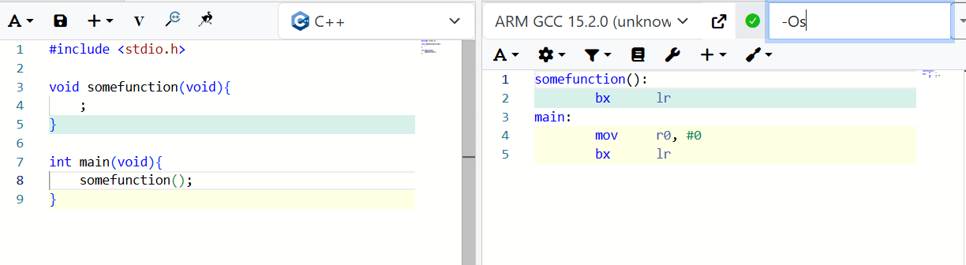
Calling a Function

Slide 5
Arm Calling Notes
LR (Link Register) = Return Address
bl = Branch with Link (copy address to LR)
NOTE: The “lr” is not something that exists on all platforms – x86/x86-64 does not have this idea and stores the return address on the stack (more on that…)

Slide 6
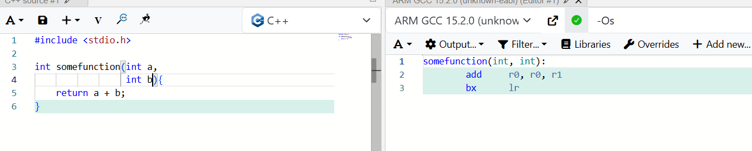
Calling Conventions

Slide 7
Guess so far
Passed arguments:
  R0 = Argument 0
  R1 = Argument 1
Return values:
  R0 = Return value

Slide 8
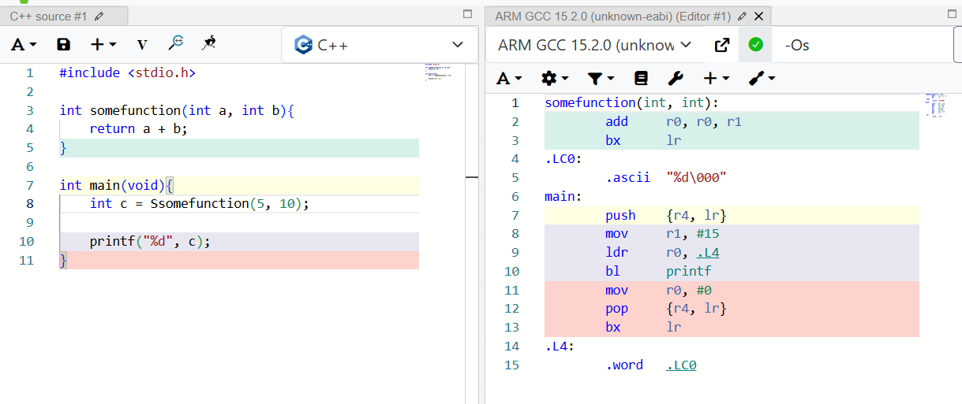
Sidenote: calling conventions & -Os

Slide 9
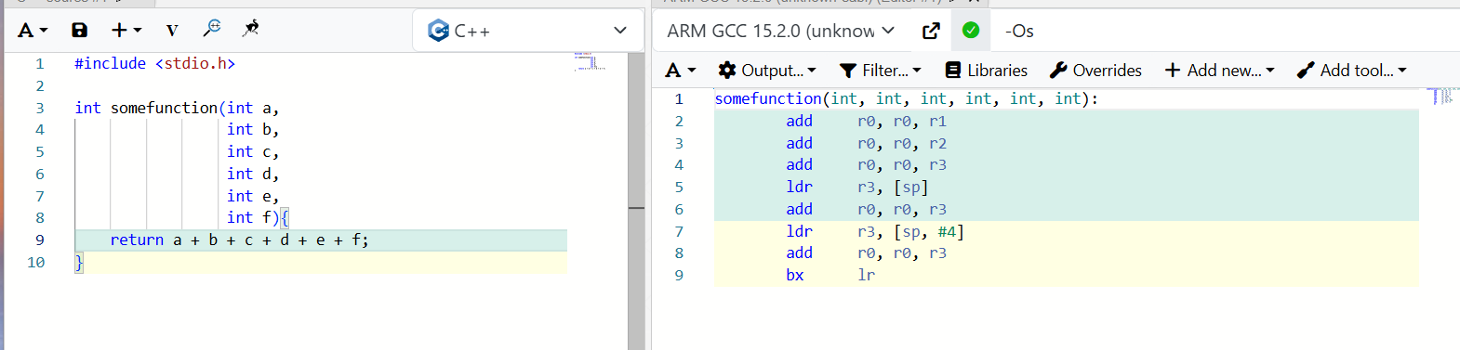
…what is “sp”

Slide 10
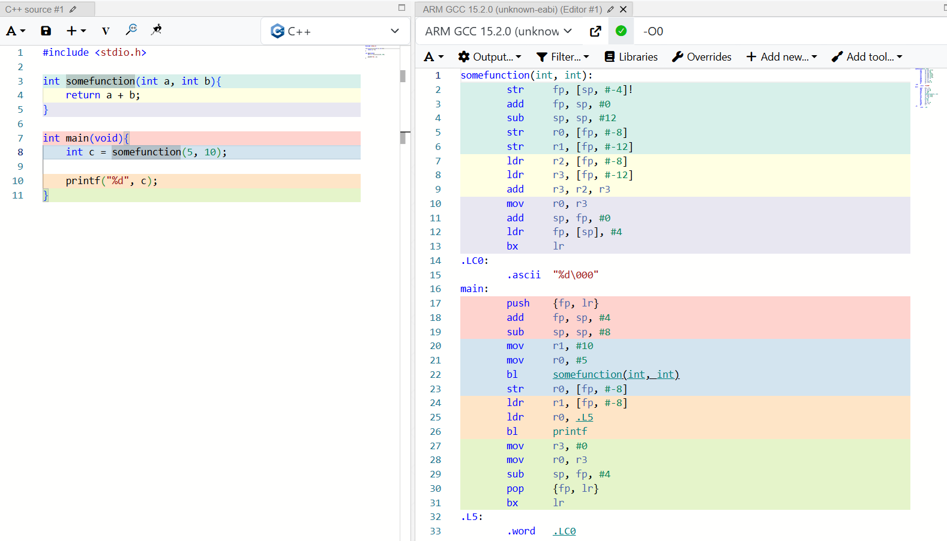
The Stack

Slide 11
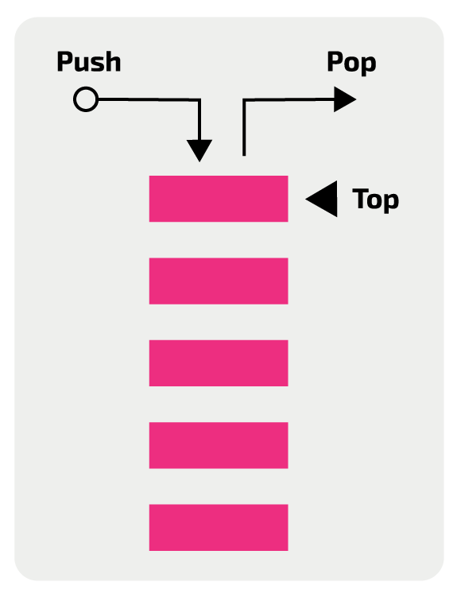
The Stack

Slide 12
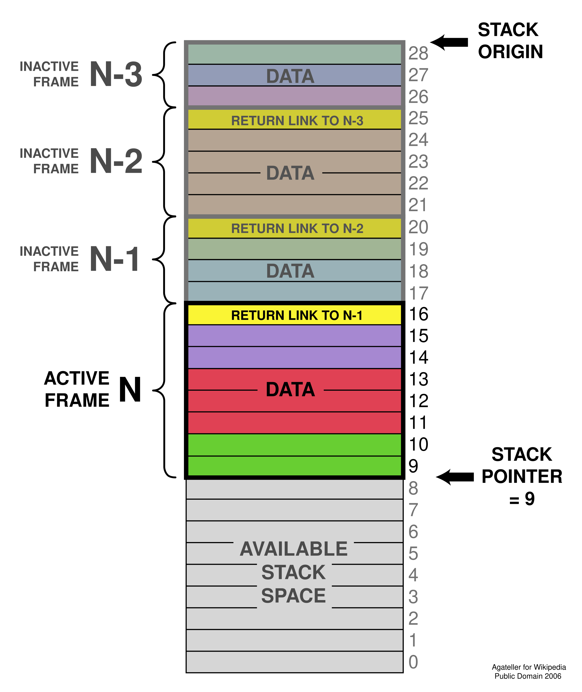
The Stack

Slide 13
The Stack
IMPORTANT: Stack is just memory (RAM). We give it a special name but nothing stops you from read/writing to the stack.
…also nothing stops the stack space from read/writing into memory…

Slide 14
Stack Growth
Stack normally grows downward on newer embedded platforms (Arm/AVR), but check on others

Slide 15
Stack & Variable Storage?
Stack also stores local variables.
WARNING: Stack can collide with memory – this results in memory corruption and other issues.
CHECKING STACK SIZE: You can write known patterns to memory & inspect how far “overwritten” they got:

Slide 16
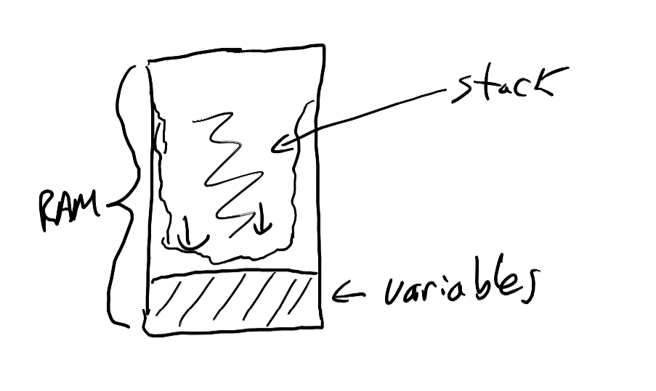

Slide 17
Prologue & Epilogue
Prologue
Epilogue

Slide 18
Copy/Paste Slide (Ignore)
#include <stdio.h>
int somefunction(int a,
int b){
int i,j,k,l,m,n,o,p;
for (int i = 0; i < a; i++){
k++;
k += b;
l += 3;
m += 4;
n += 5;
o += 6;
p += 7;
}
return a + b + k + l + m + n + n + o + p;
}

Slide 19
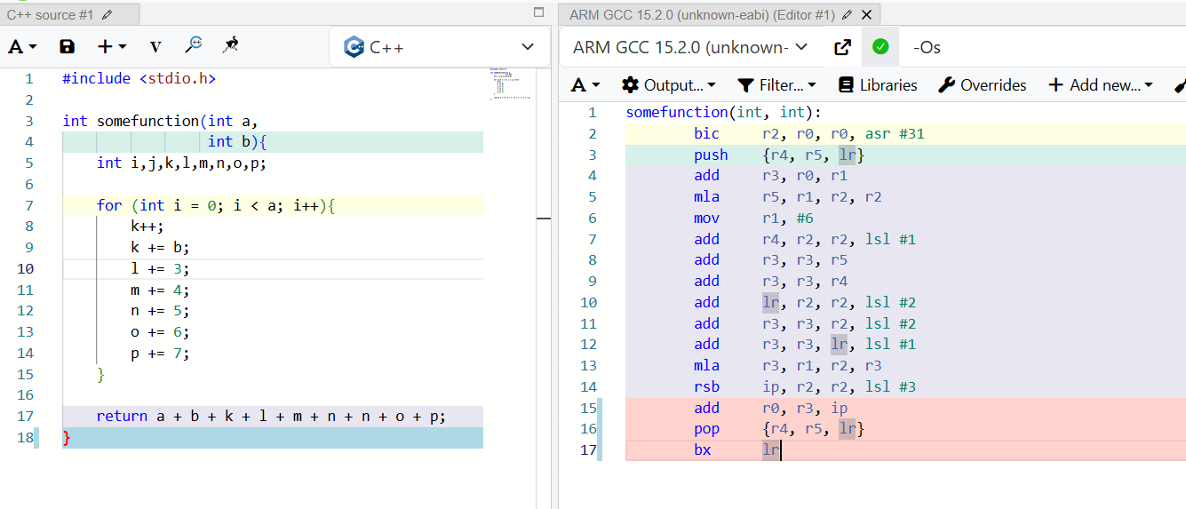
Caller-saved Registers
Notes:
#include <stdio.h>
int somefunction(int a,
int b){
int i,j,k,l,m,n,o,p;
for (int i = 0; i < a; i++){
k++;
k += b;
l += 3;
m += 4;
n += 5;
o += 6;
p += 7;
}
return a + b + k + l + m + n + n + o + p;
}

Slide 20
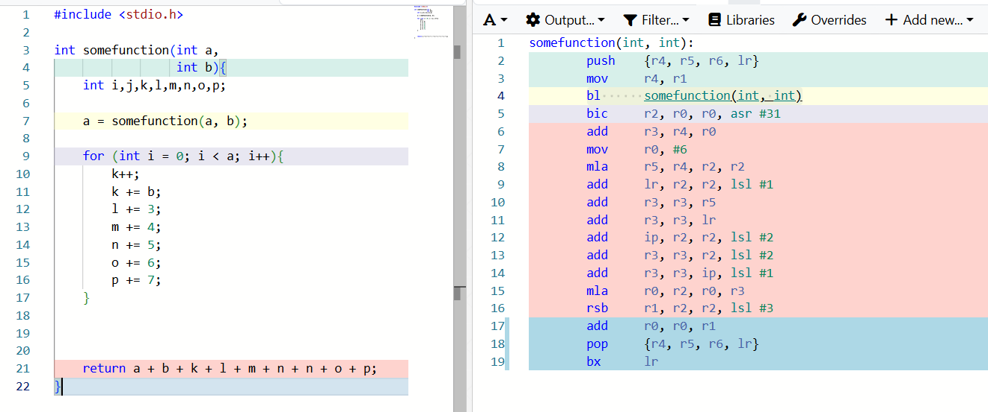
Callee-saved Registers

Slide 21
ARM Cortex-M Calling Conventions & Registers
Arguments:
  First 4: r0 – r3
  Remaining: stack
Return value in r0
Registers:
  Caller-saved: r0-r3, r12
    HINT: r0-r3… see above
  Callee-saved r4-r11
Link Register (LR)
  R14
  May be reused as a “regular register”
Intra-procedure-call scratch register (IP)
  R12
  May be reused as a “regular register”

Slide 22
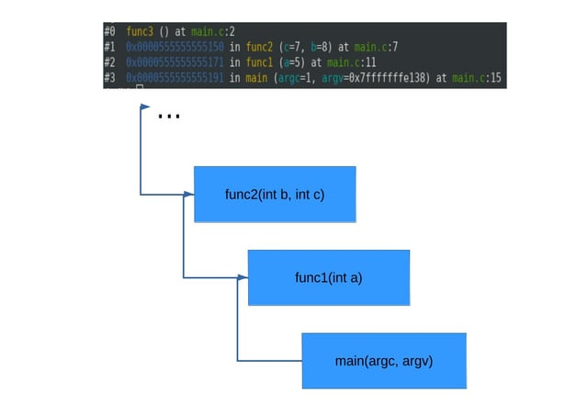
Stack Trace & Debuggers
Remember: each of these is a Stack Frame

Slide 23
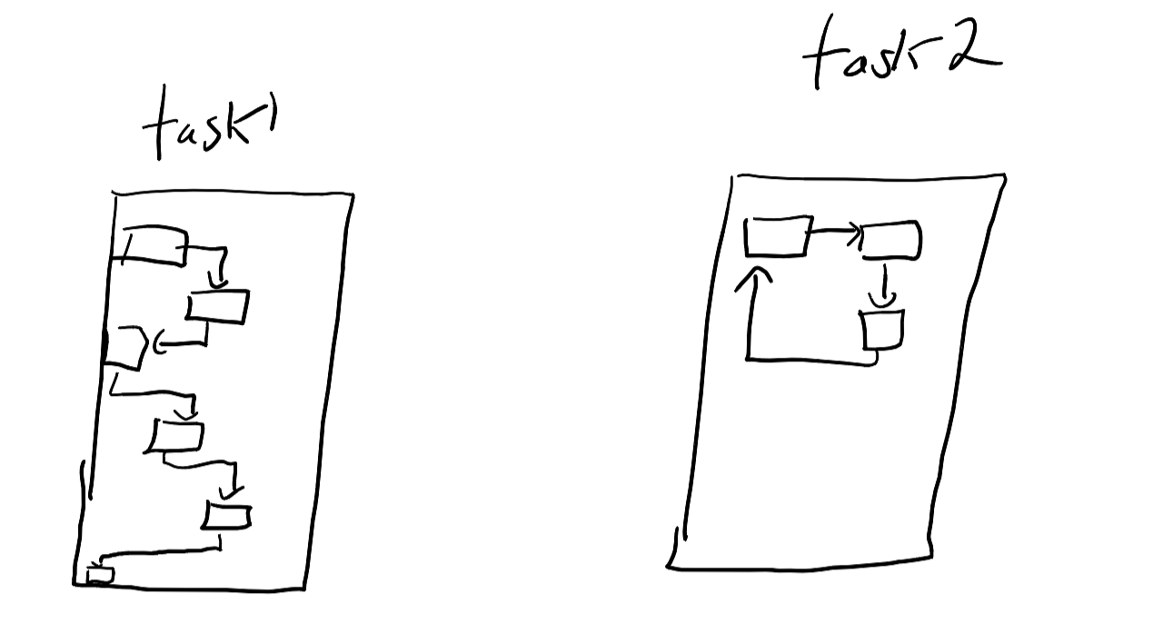
Stack Frames & Context Switching

Slide 24
Context Switching
We can save and restore the system context:
  All registers
  Naturally saves & restores stack pointer
  Requires us to setup memory segments so these do not overlap

Slide 25
Lab & Assignment Explorations
Lab #1 is about debugger usage – but you can also take a look at stack frames in the debugger.
You’ll be asked to look in more detail of these stack frames in later Labs & assignments, but I suggest taking a look at it in your first lab to get an understanding for the tools.

Slide 26
Stack Summary
The Stack is memory used by functions:
  Arguments
  Local storage
  Return address (sometimes)
On most systems nothing stops stack overrun
The Stack Frame is a specific section of memory used by each function.
  We can trace through Stack Frames to understand call order (“stack trace”)
Callee vs. Caller-Saved
  Critical to understand who is responsible for saving register state
  Caller-saved registers normally used for argument passing anyway

